Slide 1


Heart Disease Diagnostic Analysis

Slide 2
Introduction
This presentation explores a comprehensive analysis of heart disease diagnoses using Power BI. Our dashboard provides a detailed overview of key metrics and trends related to heart disease, leveraging data to uncover patterns and insights. Through this analysis, we aim to enhance understanding and support informed decision-making in healthcare settings.

Slide 3
Data Overview
The dataset encompasses a range of variables pertinent to heart disease diagnoses, including patient demographics, clinical features, and diagnostic outcomes. Key metrics analyzed include:
Prevalence by Demographics: Distribution of heart disease across different age groups, genders, and ethnicities.
Clinical Indicators: Examination of risk factors such as blood pressure, cholesterol levels, and heart rate.
Diagnostic Trends: Trends over time and geographic distribution of diagnoses.
Outcomes and Prognosis: Analysis of treatment outcomes and prognosis based on diagnostic categories.

Slide 4
Main KPIs Used
Average Blood Pressure
Average Blood Sugar Levels
Average Cholesterol Levels
Chest Pain Incidence Rate
Proportion of High-Risk Individuals

Slide 5
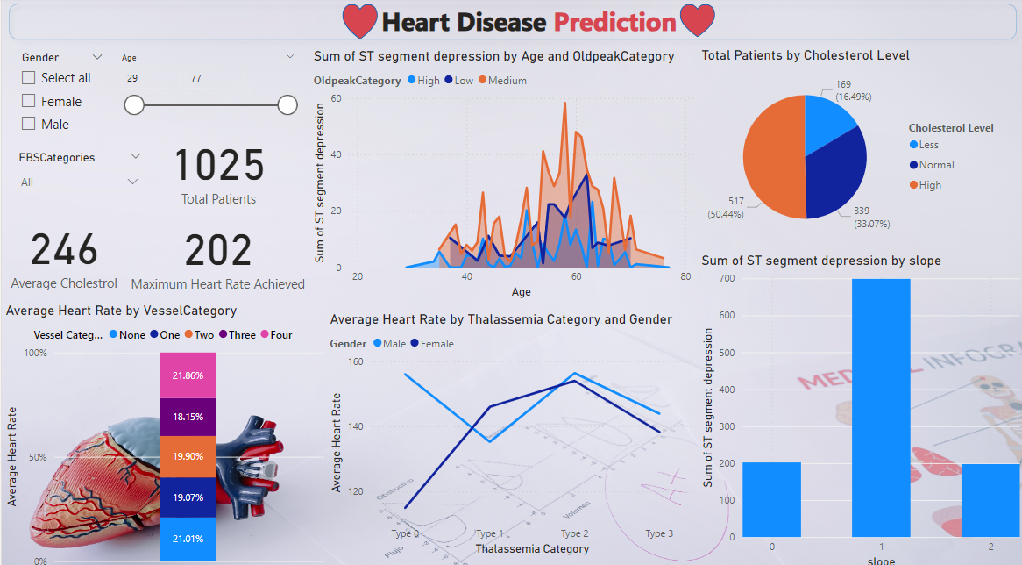
Dashboard

Slide 6

Thank you
Name – Kartik
UNID – UMIP15423
Batch – 04-07-2024 to 05-08-2024

